Slide 1
Socket programming
12

Slide 2
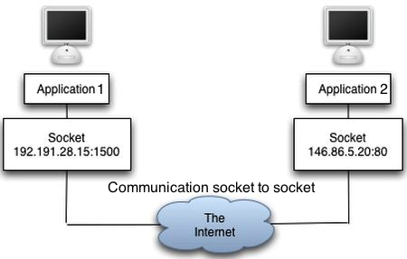
Socket
Was invented in Berkeley for Linux.
Type of stream – a network one!
THE object you are going to use for talking with other computers
Combined of IP + Port

Slide 3
Socket – How?
I want to talk to Roni’s computer
Roni’s computer opens a server socket, listening for incoming requests on certain port (for example, 1500)
I’m creating a socket connecting to Roni’s IP with port 80
Roni’s socket sees someone wants to connect to him! He creates a new client socket on Roni’s side, and now both are connected!

Slide 4






Socket – How?
So we now have 2 client sockets – one on my side, one on his side, talking to each other!
And the server socket keeps listening to other requests ☺
Cool editing right? (the picture)

Slide 5
Socket – How?
Now, Whenever I want to send something to Roni – I’m going to write it to the socket. And he’s going to listen!
Same for him writing me something

Slide 6
Let’s See Some Syntax!
So, how do we use those beasts?
We send, and then we receive
We close when we finish using (like what?)
Only binary (we decode and encode)
We need to pre-agree on what we send over the connection.
**Pycharm example**
Notes:
Notice the pycharm example should explain how to:
Create server socket
Create client socket
Usage of them

Slide 7

Ok Bro.. How do we know you stopped talking?
Fixed length message
Stop reading combination

Slide 8
Small Exercise
Imagine your self esteem is pretty low. And you just want someone to agree with you. Let’s make a program for that!
Create a server-client program satisfying:
The server waits for one connection
When accepting, sends a friendly hello to the client through the socket
Afterwards, when the client sends a message to the server (max size:1024), the server responds with message+” sounds smart!”
The client prints everything he gets. (Notice that you should read-write-read-write.

Slide 9
Small Exercise #2
Let’s transfer a file via socket. As before, create a server-client program, where the client reads a file from the file system and sends it to the server.
Woho!

Slide 10
Small Exercise #3
Let’s transfer a file via socket. As before, create a server-client program, where the client creates the zoo object, adds a couple of lions into it, and sends it to the server where the lions are saved into a SQL Table of all Lions.
Woho!

